Slide 1



UE23CS328C NLP Empowerment: Delving into Prompt Engineering and LLMs for enhanced capabilities
Day 4
Presenter: Dr. Arti arya

Slide 2
DISCLAIMER
I would like to thank Prof. Ananthnaagu for drafting these set of slides. Further changes are incorporated by me and also additional content is added to it. The content of the slides are from all reliable sources and some course by renowned researchers in the area. The references are given at the end.

Slide 3
Today’s Agenda
Transformers, GPT
Evolution of GPT
Generative AI
Foundation Models
A quick note on SSL
LLMs
Prompts and Prompt Engineering

Slide 4
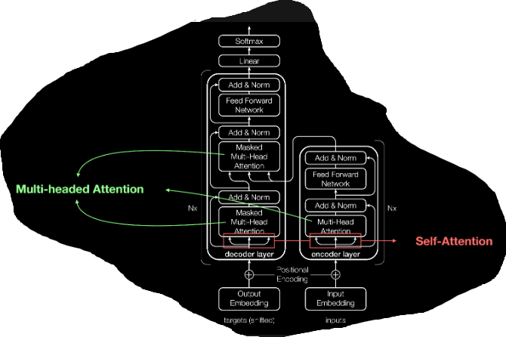

NLP: Transformers , the Game Changer
Initiated and proposed by Googlers

Slide 5







NLP: Transformers , the Game Changer
Vaswani, Ashish, Noam Shazeer, Niki Parmar, Jakob Uszkoreit, Llion Jones, Aidan N. Gomez, Łukasz Kaiser, and Illia Polosukhin. "Attention is all you need." Advances in neural information processing systems 30 (2017).
Ashish Vaswani and Nikki Parmar
Illia Polosukhin
Jakob Uszkoreit Llion Jones
Noam Shezar
Aidan N. Gomez Łukasz Kaiser
Initiated and proposed by Googlers

Slide 6
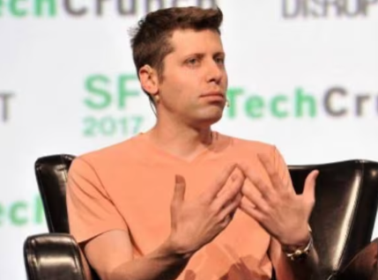
NLP: Generative Pretrained Transformers , the Game Changer
Further pathbreaking work by OpenAI
(a startup Backed by Microsoft,
CEO: Sam Altman)
(He recently stated in one of his talks recently at MIT: “ The era of giant AI models is already over”)
Generative pre-trained transformers (GPT) are a type of Large Language Models(LLM) and a prominent framework for generative AI.
The first GPT was introduced in 2018 by OpenAI.

Slide 7

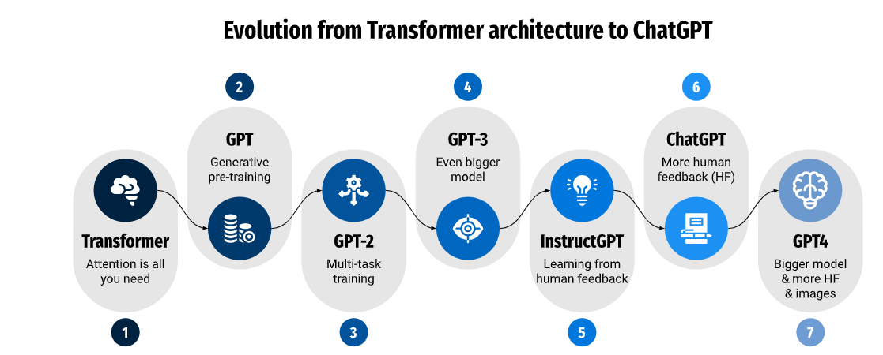

Evolution of Transformers
2018
2020
2022
2017
2019
2022
2023
Source: Kocoń, Jan, Igor Cichecki, Oliwier Kaszyca, Mateusz Kochanek, Dominika Szydło, Joanna Baran, Julita Bielaniewicz et al. "ChatGPT: Jack of all trades, master of none." Information Fusion (2023): 101861.

Slide 8

NLP: Generative AI
Not new, has been around since 2014: GANs
( Ian Goodfellow and his colleagues)
Generative AI is a type of AI that can create new content and ideas, including conversations, stories, images, videos, and music.
Generative AI models learn to create new data samples that have similar statistical properties to the training data.
A buzz word since ChatGPT has come to public though DALL-E, VAEs etc are all generative models.

Slide 9
NLP: Foundation Models
BERT and GPT are both foundation models.
Let’s look at the definition and characteristics:
Pre-trained on different types of unlabeled datasets (e.g., language and images)
Self-supervised learning
Generalized data representations which can be used in multiple downstream tasks (e.g., classification and generation)
The Transformer architecture is mostly used, but not mandatory

Slide 10

NLP: A quick short note on SSL
An evolving ML technique to solve the challenges posed by the over-dependence of labeled data.
So far ML methods has been largely dependent on good quality labeled data.
And the cost of high-quality annotated data is a major bottleneck in the overall training process.
Practically, it is impossible to collect and label all kinds of varied data.

Slide 11
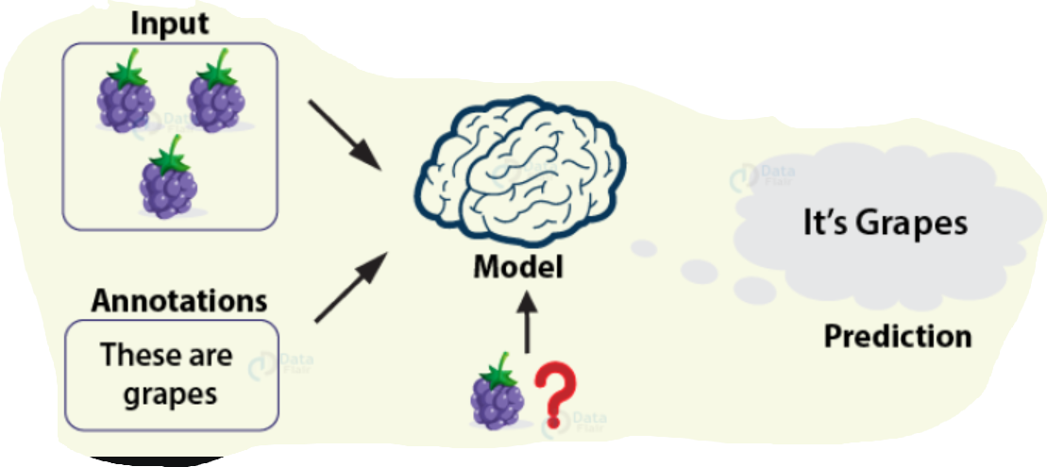
NLP: Guess what kind of learning is this?

Slide 12
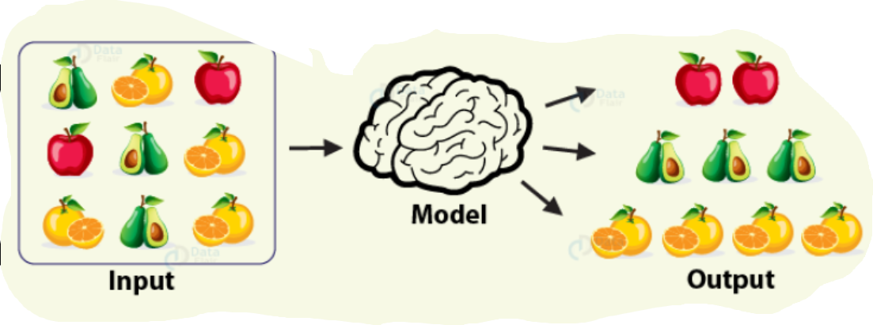
NLP: Guess what kind of learning is this?

Slide 13
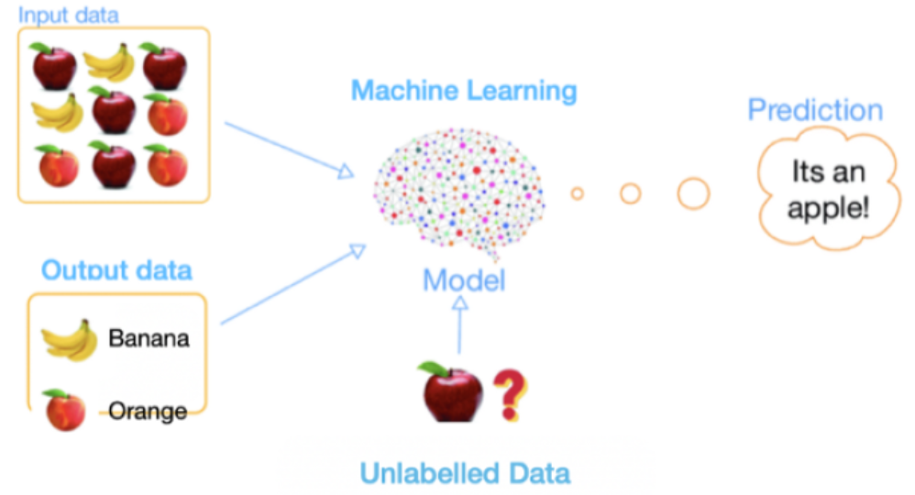
NLP: Guess what kind of learning is this?

Slide 14
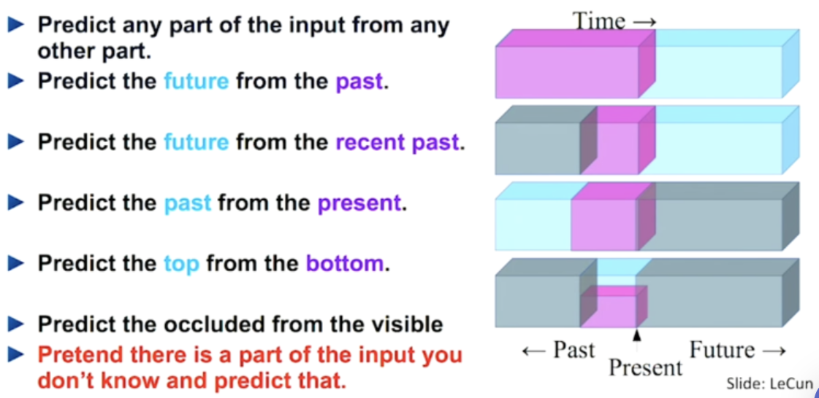
NLP: A quick short note on SSL
Self-supervised learning is a ML process where the model trains itself to learn one part of the input from another part of the input. It is also known as predictive or pretext learning.

Slide 15

Why we need SSL?
Bcoz existing learning models get trained at:
High Cost: The cost of good quality labelled data is very high in terms of time and money.
Lengthy Lifecycle:
The data preparation lifecycle, a lengthy process
It requires cleaning, filtering, annotating, reviewing, and restructuring according to the training framework.
Generic AI:
The self-supervised learning framework is one step closer to embedding human cognition in machines.

Slide 16

NLP: Foundation Models
In 2017 transformers were introduced: “Attention is all you need”.
The next generation of RNNs and LSTM architectures and have several benefits:
Parallel processing: Increases performance and scalability
Bidirectionality: Allows understanding of ambiguous words and coreferences.
The original transformer architecture defines two main parts, an encoder and a decoder.
However, not all foundation models use both parts. BERT only uses encoders, GPT only decoders.

Slide 17

NLP: Large Language Models
Large language models (LLMs) are recent advances in deep learning models to work on human languages.
An LLM is a trained deep-learning model that understands and generates text in a humanly manner.
Behind the scene, it is a large transformer model that does all the magic.

Slide 18


Prompt before Prompt Engineering
Specific instruction, question, or stimulus provided to initiate a response or action from an individual or an AI system.
In the context of LMs like GPT-3.5, a prompt is the input text or query given to the model to generate a relevant and coherent response.

Slide 19

Prompt before Prompt Engineering
They can range from simple, straightforward questions to more complex and nuanced downstream tasks that require the AI to synthesize information, draw inferences, or provide creative solutions.
The quality and clarity of a prompt can greatly influence the output generated by the AI model, making it crucial to craft prompts that effectively convey the user’s intent and desired outcome.

Slide 20

Prompt Engineering
The technology demonstrates how the innovative use of language, coupled with computational power, can redefine human-machine interactions.
The driving force behind this surge is ‘prompt engineering,’ an intricate process that involves crafting text prompts to effectively guide LLMs towards accurate task completion, eliminating the need for extra model training

Slide 21

Prompt Engineering
The effectiveness of Large Language Models (LLMs) can be greatly enhanced through carefully crafted prompts.
These prompts play a crucial role in extracting superior performance and accuracy from language models.
With well-designed prompts, LLMs can bring about transformative outcomes in both research and industrial applications.
This enhanced proficiency enables LLMs to excel in a wide range of tasks, including complex question answering systems, arithmetic reasoning algorithms, and numerous others.

Slide 22

NLP: Prompt Engineering
Prompt engineering is a multidimensional field that encompasses a wide range of skills and methodologies essential for the development of robust and effective LLMs and interaction with them.
Prompt engineering involves incorporating
-safety measures,
-integrating domain-specific knowledge,
-and enhancing the performance of LLMs using customized tools.

Slide 23

NLP: Prompt Engineering: What is it?
By carefully engineering prompts, practitioners can harness the capabilities of LLMs to achieve different goals.
The process of prompt engineering entails
analyzing data and task requirements,
designing and refining prompts,
and fine-tuning the language model based on these prompts.

Slide 24



NLP: Prompt Engineering
Within 2 months of its launch, ChatGPT developed a user base of over 100 million users.
It surpassed other popular social media apps like Instagram and TikTok to become the fastest-growing app to date.

Slide 25
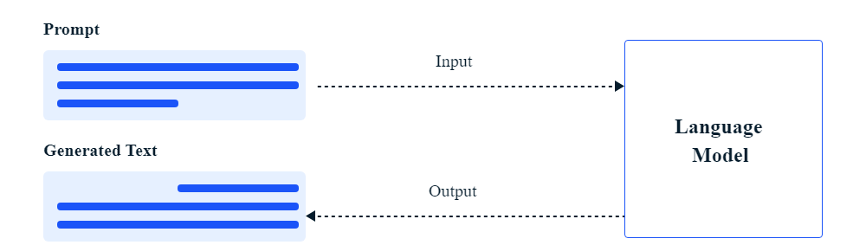

NLP: Prompt Engineering
Isa Fulford and Andrew Ng outlined two principal aspects of prompt engineering in their ChatGPT Prompt Engineering for Developers course
1. Formulation of clear and specific instructions
2. Allowing the model time to “Think”

Slide 26
NLP: Prompt Engineering
Prompts used for various AI tasks
Task | Example Prompt | Possible Output
Text Summarization | Explain antibiotics. | Antibiotics are medications used to treat bacterial infections…
Information Extraction | Mention the large language model based product mentioned in the paragraph. | The large language model based product mentioned in the paragraph is ChatGPT.
Question Answering | Answer the question based on the context below. | It was approved to help prevent organ rejection after kidney transplants.
Text Classification | Classify the text into neutral, negative, or positive. | Neutral
Conversation | The following is a conversation with an AI research assistant. | Black holes are regions of spacetime where gravity is extremely strong…
Code Generation | Ask the user for their name and say “Hello.” | let name = prompt(“What is your name?”); console.log(Hello, ${name}!);
Reasoning | The odd numbers in this group add up to an even number: 15, 32, 5, 13, 82, 7, 1. | No, the odd numbers in this group add up to an odd number: 119.

Slide 27
NLP: Prompt Engineering
Importance of prompt engineering in NLP and AI.
Maximizing model efficiency
Enhancing task-specific performance
Understanding model limitations
Increasing model safety
Enabling resource efficiency
Facilitating domain-specific knowledge transfer
Source: https://www.leewayhertz.com/prompt-engineering/

Slide 28
NLP: Example
Imagine you’re using ChatGPT to give you a summary of a book.
Possible Prompt: “Tell me about Harry Potter 1,” ……. Kind of vague prompt. ( Try This: TLDR)
Use prompt engineering techniques to create a more effective prompt.
A better prompt might be: “Please provide a concise summary of the book Harry Potter 1 by J K Rowling, including a description of its main themes and characters, in approximately 100 words.”
Or
Give concise summary of Harry Potter 1.

Slide 29

NLP: Example
In this example, the prompt is clear, specific, and provides context.
The AI model now has a better understanding of the task and can generate a more accurate and relevant summary.
Prompt engineering is an iterative process, requiring experimentation and refinement to find the most effective way to communicate the desired task to the AI model.
By mastering prompt engineering, users can obtain more accurate, relevant, and reliable results from AI models, leading to more efficient and productive interactions with larger models.

Slide 30
NLP: Prompt Engineering
Prompt Engg Techniques
Zero Shot
Few Shot

Slide 31
NLP: Prompt Engineering
N-shot prompting (zero-shot prompting and few-shot prompting)
The term “N-shot prompting” is used to represent a spectrum of approaches where N symbolizes the count of examples or cues given to the language model to assist in generating predictions.
This spectrum includes, notably, zero-shot prompting and few-shot prompting.

Slide 32

NLP: Prompt Engineering Techniques
Zero-shot prompting refers to a situation where the language model generates predictions without any explicit, additional examples.
It’s particularly effective for tasks the model has been extensively trained on classification tasks like sentiment analysis or spam detection, text transformation tasks like translation or summarization, and simple text generation. (including but not limited to)

Slide 33
NLP: Zero Shot Prompt Engineering Techniques
Let’s consider the task of sentiment analysis where the model is given a sentence and is expected to classify the sentiment as positive, negative, or neutral.
In this case, we could directly ask the model without providing any explicit training examples.
Input prompt to the model:
"What is the sentiment of the following sentence: 'I had an amazing day at the park'?"

Slide 34

NLP: Zero Shot Prompt Engineering Techniques
Given that the LM has been extensively trained on understanding sentiments during its initial training, it can typically respond to such a prompt accurately, despite not receiving specific examples in this context.
The expected response would be:
Model’s response:
"The sentiment of the sentence is positive."
In this scenario, we haven’t provided any training examples or clues, hence it’s a zero-shot prompt.

Slide 35
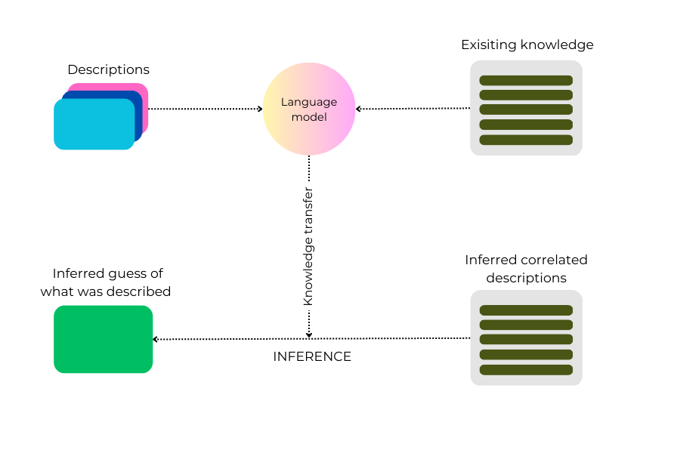

NLP: Prompt Engineering
In zero-shot prompting, the LM relies solely on its pre-existing knowledge and general understanding of natural language, as well as its ability to reason and infer

Slide 36

NLP: Prompt Engineering : An Example
Imagine you have a powerful LM like GPT-3, which has been trained on a large dataset containing text from various sources.
You want the LM to provide a summary of a given article.
Zero-shot prompting could be used by simply providing the AI model with the text of the article followed by a Prompt like “Please summarize the following article in three sentences:”.

Slide 37

NLP: Zero Shot Prompt Engineering: An Example
The AI model would then
process the input text,
extract the most important points,
and generate a summary without having been trained explicitly on the task of summarizing articles.
This is possible because GPT-3, and similar AI models, have a large language model and wide range of text during their training, allowing them to generalize and perform new tasks, like summarization even without specific examples or prior training on that task.

Slide 38
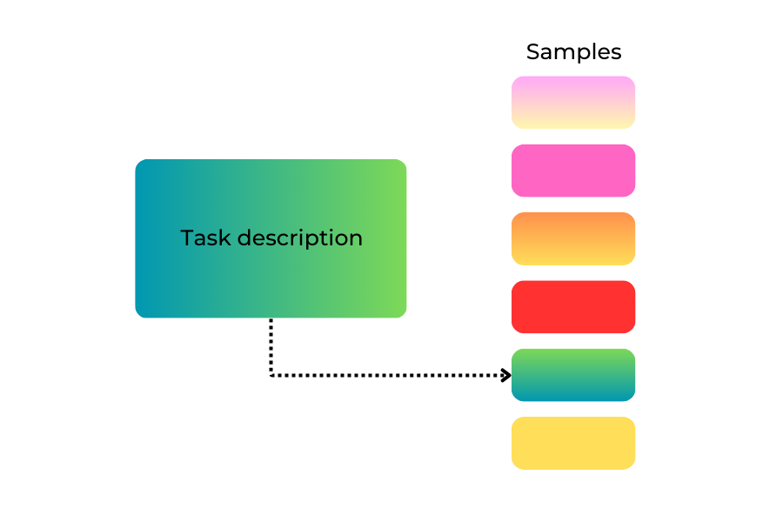

NLP: One Shot Prompt Engineering
One-shot prompting is a technique used with AI models, where the model
is given a task description and
a single example to learn from and generate a response to a given prompt.
The AI model uses this task description and example as a reference to understand the task and produce an appropriate output.

Slide 39



NLP: One Shot Prompt Engineering Example
Let’s assume you are using ChatGPT, and you want it to convert temperatures from Fahrenheit to Celsius. Instead of providing multiple examples or no examples at all, you give the AI one example to learn from.
You could provide the following prompt:

Slide 40

NLP: One Shot Prompt Engineering Example
You could provide the following prompt:
The AI model processes the example and learns that it is supposed to convert temperatures.
AI model leverages its pre-existing knowledge and general understanding of language, combined with the provided example, to perform the task at hand.
This approach can be particularly helpful when the model may struggle to infer the desired output using zero-shot prompting alone.

Slide 41
NLP: Few-Shot Prompt Engineering
It employs a limited set of examples, usually ranging from two to five, to guide the model’s output.
These instances are designed to direct the model towards improved performance in addressing more context-specific problems.
Few-shot prompts enable the model to tailor its responses more effectively, thus increasing the accuracy of its predictions.

Slide 42
NLP: Few-Shot Prompt Engineering
Let’s consider the task of generating a rhymed couplet (two-line verse) about a given topic, which is a more context-specific task and might benefit from few-shot prompting. Here is how it might look:
Input prompt to the model:
"Write a rhymed couplet about a sunflower:
Example 1: 'Sunflower with petals bright, Basking gladly in the sunlight.’
Example 2: 'Sunflower tall in the summer glow,
Nodding as the breezes blow.’
Now, write a rhymed couplet about a moonlit night."

Slide 43
NLP: Prompt Engineering
These 2 examples serve as context and steer the model towards the desired output. They essentially “tell” the model what we expect from it.
The model, given its extensive training data and the two specific examples (few-shot prompting), is expected to generate a similar rhymed couplet about a moonlit night.
Model’s response:
"Moonlight spreading its silver light,
Bathing the world in a tranquil night."

Slide 44
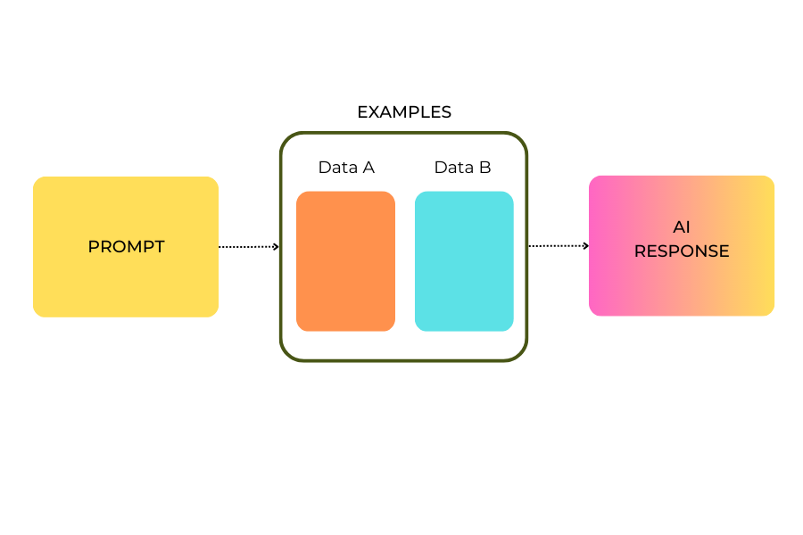
NLP: Prompt Engineering
Few-shot prompting

Slide 45
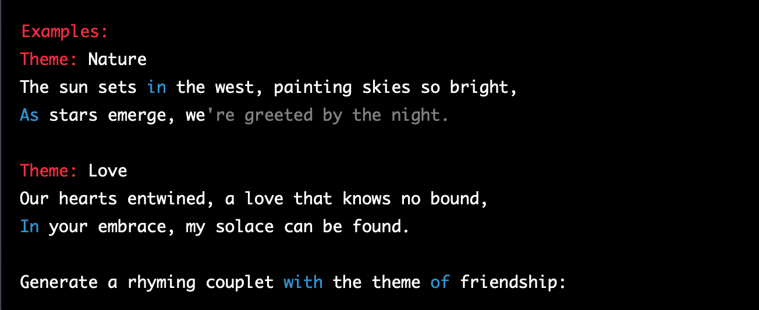
NLP: Prompt Engineering
Example 1
You are using ChatGPT, and you want it to provide rhyming couplets based on a given theme. You could provide a few examples to guide the model:

Slide 46

NLP: Prompt Engineering
By providing these examples, the AI model learns to create rhyming couplets based on a given theme and then generates a new couplet following the pattern, such as:

Slide 47
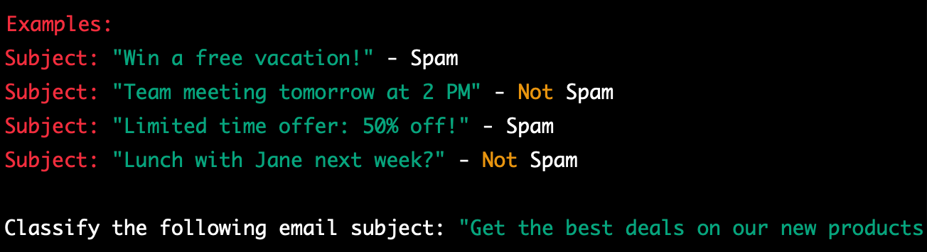
NLP: Prompt Engineering
Example 2
You want the AI model to classify emails as spam or not spam. You can provide a few examples to guide the model:
With these examples, the AI model learns to differentiate between spam and not spam.
It then classifies the given email subject, likely as “Spam.”

Slide 48

NLP: Chain-of-thought(CoT) Prompt Engineering
CoT, a technique introduced by Google researchers, operates which encourages an AI model to elucidate intermediate reasoning stages before delivering the final answer to a multi-stage issue.
This procedure allows the model to dissect intricate problems into simpler components, thereby enabling it to address challenging reasoning tasks that traditional prompting methods might not handle effectively.

Slide 49
NLP: Prompt Engineering
Let’s consider a complex problem-solving example in which Chain-of-thought (CoT) prompting can be applied.
Consider a prompt where we want a language model to solve a multi-step math word problem like this:
"John has 10 apples. He gives 3 apples to his friend Sam and then buys 6 more apples from the market.
How many apples does John have now?"
Using Chain-of-thought prompting, we would split the problem into simpler intermediate steps:

Slide 50
NLP: Prompt Engineering
Using Chain-of-thought prompting, we would split the problem into simpler intermediate steps:
Initial Prompt: "John has 10 apples.
Intermediate Prompt: "How many apples does John have if he gives 3 to Sam?
Intermediate Response: "John has 7 apples."
Initial Prompt: "John has 7 apples.
Intermediate Prompt: "How many apples will John have if he buys 6 more apples from the market?"
Intermediate Answer: "John has 13 apples."

Slide 51
NLP: Prompt Engineering
Finally, we have the answer to the original complex problem: “John has 13 apples now.”
The CoT prompting breaks down the problem into manageable pieces, allowing the model to reason through each step and then build up to the final answer.
This method helps to increase the model’s problem-solving capabilities and overall understanding of complex tasks.

Slide 52

NLP: Prompt Engineering
There are several innovative adaptations of CoT prompting, like:
Self-consistency prompting
Least-to-most prompting (LtM)
Active prompting
Generated knowledge prompting
Directional stimulus prompting
ReAct prompting
Multimodal CoT prompting
Graph prompting
The actual use of these prompts with AI models might require proper setup and interaction with the model's API or framework to obtain meaningful and desired responses.

Slide 53

NLP: Prompt Engineering
Self Consistency Prompting:
Involves asking the AI model to generate multiple responses to the same input and ensuring consistency across these responses.
It helps improve coherence and reduce output variation.
Example:
Prompt: Generate three different descriptions of a beautiful sunset over the ocean
The actual use of these prompts with AI models might require proper setup and interaction with the model's API or framework to obtain meaningful and desired responses

Slide 54

NLP: Prompt Engineering
Least-to-Most(LtM) Prompting:
AI model is gradually provided with more information in a sequence of prompts.
The goal is to start with minimal input and gradually increase it until the desired response is achieved.
Example:
Prompt: "Describe your favorite animal."
Prompt 2: "Now, provide more details about its habitat and diet."

Slide 55

NLP: Prompt Engineering
Active Prompting:
Involves actively guiding the AI model's behavior during the generation process.
It can include specifying desired attributes, style, or tone in the prompt to influence the output.
Example:
Prompt:
“Write a poem about the joy of spring, using descriptive and vibrant language."

Slide 56

NLP: Prompt Engineering
Generated Knowledge Prompting:
Prompts that encourage the AI model to demonstrate its knowledge on a specific topic or domain by generating informative responses.
Example:
Prompt:
"Explain the concept of photosynthesis to a 10-year-old."

Slide 57

NLP: Prompt Engineering
Directional Stimulus Prompting:
Provides explicit instructions to the AI model regarding the direction or focus of the response, guiding it to generate content in a particular way.
Example:
Prompt:
"Write a story about a courageous astronaut exploring an unknown planet.”

Slide 58
NLP: Prompt Engineering
ReAct Prompting:
A technique where the AI model is prompted to react to specific elements or attributes in the input, leading to more interactive and dynamic responses.
Example:
Prompt:
"You just received a surprise gift. Express your reaction and gratitude.”

Slide 59
NLP: Prompt Engineering
Multimodal Prompting:
Involves providing multimodal (text and image, for example) prompts to the AI model to influence its response generation using a combination of different data types.
Example:
Prompt:
"Describe this image of a serene forest with a beautiful waterfall.

Slide 60
NLP: Prompt Engineering
Graph Prompting:
Utilizes graph-structured data as prompts to guide the AI model's understanding and output generation..
Example:
Prompt:
"Using the provided graph, explain the trends in global temperature over the past century.”

Slide 61

NLP: Prompt Engineering: A step-by-step process
Prompt engineering is a multi-step process that involves several key tasks. Here they are:
Understanding the problem
Question-answering tasks
Text generation tasks
Sentiment analysis tasks
Crafting the initial prompt
Evaluating the model’s response
Iterating and refining the prompt
Testing the prompt on different models
Scaling the prompt

Slide 62
NLP: Prompt Engineering Applications
Generating data
Generating data is an important application of prompt engineering with large language models (LLMs). LLMs have the ability to generate coherent and contextually relevant text, which can be leveraged to create synthetic data for various purposes.
Example:
Prompt:
Generate 100 question-answer pairs about famous landmarks.

Slide 63

NLP: Prompt Engineering Applications
Program-aided Language Model (PAL)
It involve integrating programmatic instructions and structures to enhance the capabilities of language models. By incorporating additional programming logic and constraints, PAL enables more precise and context-aware responses.
Example
Prompt:
Given a list of numbers, compute the sum of all even numbers.
Input: [2, 5, 8, 10, 3, 6]
Output: The sum of all even numbers is 26.

Slide 64
NLP: Prompt Engineering Applications
Generating code
Generating code is another application of prompt engineering with large language models.
LLMs can be prompted to generate code snippets, functions, or even entire programs, which can be valuable in software development, automation, and programming education.
Example
Prompt:
Write a Python function named "factorial" that takes an integer as input and returns its factorial.

Slide 65
NLP: Prompt Engineering
Applications of prompt engineering
By providing this specific prompt to the LLM, it can generate code that implements the factorial function in Python:
Generated Code:
def factorial(n):
if n == 0 or n == 1:
return 1
else:
return n * factorial(n - 1)

Slide 66

NLP: Risks associated with Prompting and Solutions
Adversarial prompting
Adversarial prompting refers to the intentional manipulation of prompts to exploit vulnerabilities or biases in language models, resulting in unintended or harmful outputs.
Adversarial prompts aim to trick or deceive the model into generating misleading, biased, or inappropriate responses.
Prompt injection:
Prompt injection is a technique used in adversarial prompting where additional instructions or content is inserted into the prompt to influence the model’s behavior.
By injecting specific keywords, phrases, or instructions, the model’s output can be manipulated to produce desired or undesired outcomes.
Prompt injection can be used to introduce biases, generate offensive or harmful content, or manipulate the model’s understanding of the task.

Slide 67

NLP: Risks associated with Prompting and Solutions
Prompt leaking:
Prompt leaking occurs when sensitive or confidential information unintentionally gets exposed in the model’s response.
This can happen when the model incorporates parts of the prompt, including personally identifiable information, into its generated output.
Prompt leaking poses privacy and security risks, as it may disclose sensitive data to unintended recipients or expose vulnerabilities in the model’s handling of input prompts.

Slide 68

NLP: Risks associated with Prompting and Solutions
Jailbreaking:
In the context of prompt engineering, jailbreaking refers to bypassing or overriding safety mechanisms put in place to restrict or regulate the behavior of language models.
It involves manipulating the prompt in a way that allows the model to generate outputs that may be inappropriate, unethical, or against the intended guidelines.
Jailbreaking can lead to the generation of offensive content, misinformation, or other undesirable outcomes.

Slide 69

NLP: Risks associated with Prompting and Solutions
Biases
Biases in LLMs pose a significant risk as they can lead to the generation of problematic and biased content.
These biases can adversely impact the performance of the model in downstream tasks and perpetuate harmful stereotypes or discriminatory behavior.

Slide 70
NLP: Risks associated with Prompting and Solutions
To address these, it is essential to implement appropriate solutions:
Effective prompting strategies: Crafting well-designed prompts can help mitigate biases to some extent
Moderation and filtering: Implementing robust moderation and filtering mechanisms can help identify and mitigate biased content generated by LLMs
Diverse training data: Training LLMs on diverse datasets that encompass a wide range of perspectives and experiences can help reduce biases
Post-processing and debiasing techniques: Applying post-processing techniques to the generated output can help identify and mitigate biases.

Slide 71
References
References:
[1]Enhancing ChatGPT’s performance with Prompt Engineering
[2] https://innodata.com/how-to-enhance-chatgpt-with-prompt-engineering/
[3] Addressing biases and ethical considerations in prompt engineering
[4]https://navveenbalani.dev/index.php/articles/ethical-prompt-engineering-a-pathway-to-responsible-ai-usage/
[5] https://www.cloudbooklet.com/fine-tuning-a-chatgpt-model-the-ultimate-guide-to-optimizing-your-conversational-ai/
[6] https://www.promptingguide.ai/notebooks
[7] https://saturncloud.io/blog/the-impact-of-transfer-learning-and-fine-tuning-on-chatgpts-conversational-performance/
[8] https://www.leewayhertz.com/prompt-engineering/
[9]https://chatgpt4.uk/the-power-of-chatgpt-fine-tuning/
[10]https://renaissancerachel.com/prompting/

Slide 72


